Slide 1

Automatically Populating an Ontology by using a ProCyclingStats scraper
Semantic Web Technology
Project Presentation
#JodyBernal 🦄

Slide 2
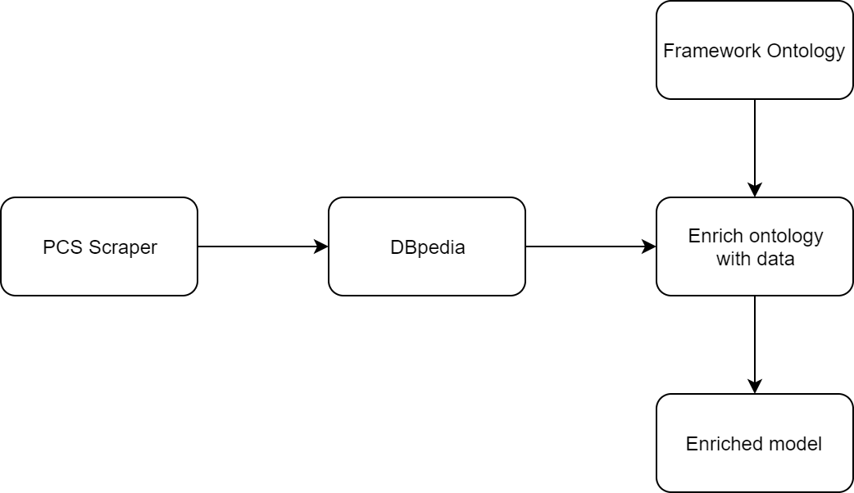
Introduction
Data
Scraper
DBpedia
Method
Results

Slide 3

Data
ProCyclingStats
DBpedia

Slide 4
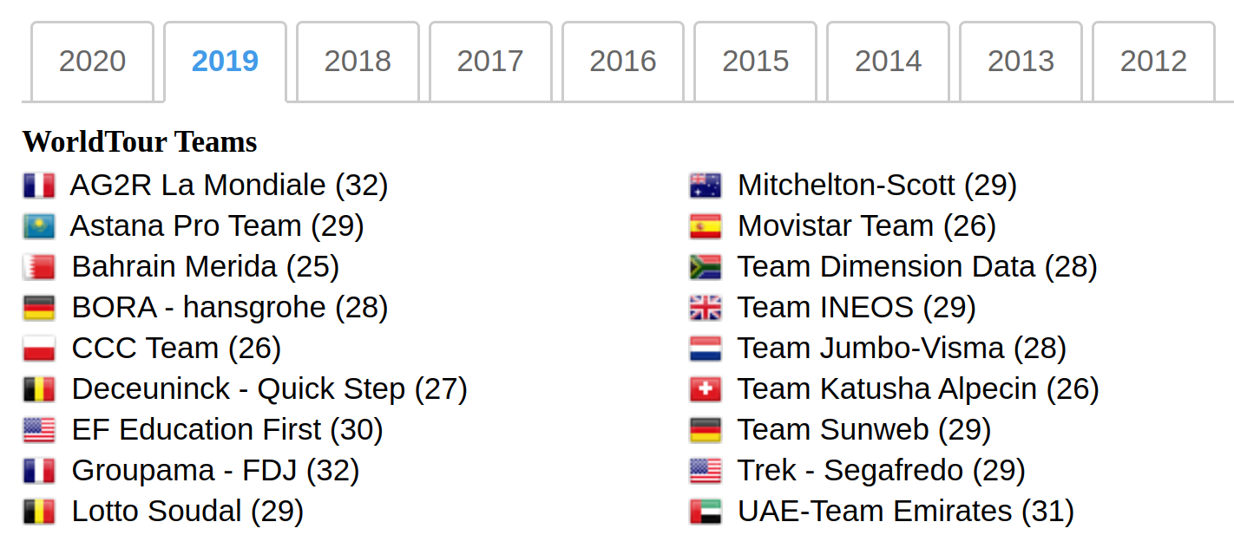
Scraper
BeautifulSoup
Based on Sudhir (2017)¹
Find all teams
Download team pages
Find all riders
Download rider pages
1. https://github.com/arjunsudhir/procyclingstats

Slide 5
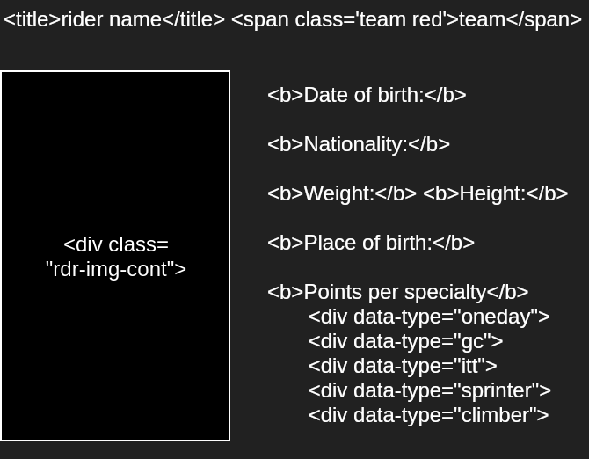
Scraper
Extract team information
Extract rider information
Stored in python dicts
JSON files for teams and riders

Slide 6
Scraper
"Damien Howson": {"uci_rank": 360, "dbo:height": 1.88, "dbo:GivenName": "Damien", "dbo:nationality": "Australia", "dbo:cyclistGenre": "gc", "dbo:proTeam": "Mitchelton-Scott", "dbo:Surname": "Howson", "dbo:birthDate": "1992-08-13", "dbo:birthPlace": "Adelaide", "dbo:weight": 68.0}, "Adam Roberge": {"uci_rank": 857, "dbo:height": null, "dbo:GivenName": "Adam", "dbo:nationality": "Canada", "dbo:cyclistGenre": "tt", "dbo:proTeam": "Elevate - KHS Pro Cycling", "dbo:Surname": "Roberge", "dbo:birthDate": "1997-03-27", "dbo:birthPlace": "Montreal", "dbo:weight": null}, "Paul Rudys": {"uci_rank": null, "dbo:height": 1.79, "dbo:GivenName": "Paul", "dbo:nationality": "Germany", "dbo:cyclistGenre": "climber", "dbo:proTeam": "LKT Team Brandenburg", "dbo:Surname": "Rudys", "dbo:birthDate": "1998-06-1", "dbo:birthPlace": "Pinneberg", "dbo:weight": 60.0}, "Sam Oomen": {"uci_rank": 353, "dbo:height": null, "dbo:GivenName": "Sam", "dbo:nationality": "Netherlands", "dbo:cyclistGenre": "gc", "dbo:proTeam": "Team Sunweb", "dbo:Surname": "Oomen", "dbo:birthDate": "1995-08-15", "dbo:birthPlace": "Tilburg", "dbo:weight": null}, "Anders Skaarseth": {"uci_rank": 530, "dbo:height": null, "dbo:GivenName": "Anders", "dbo:nationality": "Norway", "dbo:cyclistGenre": "sprinter", "dbo:proTeam": "Uno-X Norwegian Development Team", "dbo:Surname": "Skaarseth", "dbo:birthDate": "1995-05-7", "dbo:birthPlace": null, "dbo:weight": null}, "Irish Valenzuela": {"uci_rank": 2527, "dbo:height": null, "dbo:GivenName": "Irish", "dbo:nationality": "Philippines", "dbo:cyclistGenre": "sprinter", "dbo:proTeam": "7 Eleven Cliqq - air21 by Roadbike Philippines", "dbo:Surname": "Valenzuela", "dbo:birthDate": "1987-04-3", "dbo:birthPlace": null, "dbo:weight": null}, "Nilo Valdez ": {"uci_rank": null, "dbo:height": null, "dbo:GivenName": "Nilo", "dbo:nationality": "Philippines", "dbo:cyclistGenre": null, "dbo:proTeam": "7 Eleven Cliqq - air21 by Roadbike Philippines", "dbo:Surname": "Valdez", "dbo:birthDate": "1995-09-12", "dbo:birthPlace": null, "dbo:weight": null}, "Fabio Van Den Bossche": {"uci_rank": null, "dbo:height": null, "dbo:GivenName": "Fabio", "dbo:nationality": "Belgium", "dbo:cyclistGenre": "gc", "dbo:proTeam": "Sport Vlaanderen - Baloise", "dbo:Surname": "Bossche", "dbo:birthDate": "2000-09-21", "dbo:birthPlace": null, "dbo:weight": 64.0}, "Ludvik Holstad ": {"uci_rank": null, "dbo:height": null, "dbo:GivenName": "Ludvik", "dbo:nationality": "Norway", "dbo:cyclistGenre": "classic", "dbo:proTeam": "Joker Fuel of Norway", "dbo:Surname": "Holstad", "dbo:birthDate": "1998-08-1", "dbo:birthPlace": null, "dbo:weight": null}, "Shogo Ichimaru": {"uci_rank": null, "dbo:height": 1.72, "dbo:GivenName": "Shogo", "dbo:nationality": "Japan", "dbo:cyclistGenre": "gc", "dbo:proTeam": "Shimano Racing Team", "dbo:Surname": "Ichimaru", "dbo:birthDate": "1992-01-4", "dbo:birthPlace": null, "dbo:weight": 72.0}, "Przemys\u0142aw Kasperkiewicz": {"uci_rank": 1353, "dbo:height": 1.82, "dbo:GivenName": "Przemys\u0142aw", "dbo:nationality": "Poland", "dbo:cyclistGenre": "sprinter", "dbo:proTeam": "Delko Marseille Provence", "dbo:Surname": "Kasperkiewicz", "dbo:birthDate": "1994-03-1", "dbo:birthPlace": "Kalisz", "dbo:weight": 71.0}, "Antonio Nibali": {"uci_rank": 2427, "dbo:height": 1.8, "dbo:GivenName": "Antonio", "dbo:nationality": "Italy", "dbo:cyclistGenre": "gc", "dbo:proTeam": "Bahrain Merida", "dbo:Surname": "Nibali", "dbo:birthDate": "1992-09-23", "dbo:birthPlace": "Messina", "dbo:weight": 65.0}, "Luis Mendon\u00e7a": {"uci_rank": 1030, "dbo:height": null, "dbo:GivenName": "Luis", "dbo:nationality": "Portugal", "dbo:cyclistGenre": "sprinter", "dbo:proTeam": "Radio Popular Boavista", "dbo:Surname": "Mendon\u00e7a", "dbo:birthDate": "1986-01-16", "dbo:birthPlace": null, "dbo:weight": null}, "Christopher Heider": {"uci_rank": null, "dbo:height": 1.8, "dbo:GivenName": "Christopher", "dbo:nationality": "Germany", "dbo:cyclistGenre": "climber", "dbo:proTeam": "Dauner D&DQ-Akkon", "dbo:Surname": "Heider", "dbo:birthDate": "1996-07-12", "dbo:birthPlace": null, "dbo:weight": 72.0}, "Jan Bakelants": {"uci_rank": 462, "dbo:height": 1.77, "dbo:GivenName": "Jan", "dbo:nationality": "Belgium", "dbo:cyclistGenre": "gc", "dbo:proTeam": "Team Sunweb", "dbo:Surname": "Bakelants", "dbo:birthDate": "1986-02-14", "dbo:birthPlace": " Oudenaarde", "dbo:weight": 67.0}, "Mauro Finetto": {"uci_rank": 517, "dbo:height": 1.77, "dbo:GivenName": "Mauro", "dbo:nationality": "Italy", "dbo:cyclistGenre": "classic", "dbo:proTeam": "Delko Marseille Provence", "dbo:Surname": "Finetto", "dbo:birthDate": "1985-05-10", "dbo:birthPlace": "Tregnago", "dbo:weight": 65.0}, "Alexandr Ovsyannikov": {"uci_rank": 1588, "dbo:height": null, "dbo:GivenName": "Alexandr", "dbo:nationality": "Kazakhstan", "dbo:cyclistGenre": "gc", "dbo:proTeam": "Vino - Astana Motors", "dbo:Surname": "Ovsyannikov", "dbo:birthDate": "1997-05-30", "dbo:birthPlace": null, "dbo:weight": null}, "Kamil Zieli\u0144ski": {"u
217 teams
106 missing data points
3197 riders
7318 missing data points

Slide 7
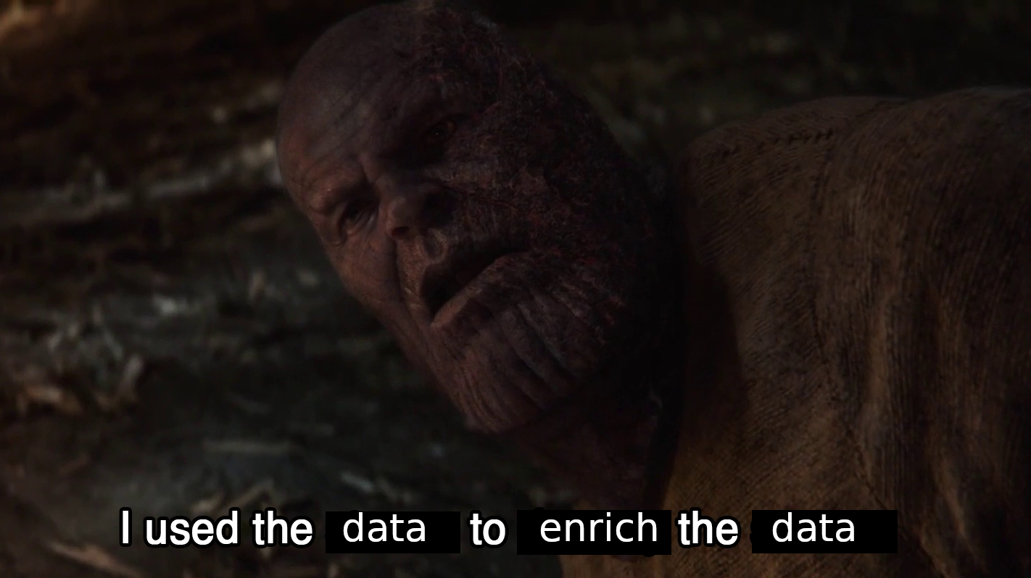
Enrich data with DBpedia

Slide 8
Enrich data with DBpedia
Retrieve riders and teams resources
SPARQL-queries
10000 limit
Compare riders and team DBpedia with ProCyclingStats
Add missing data
Correct false data
Add URI to data

Slide 9
Method
Scrape data ProCyclingStats
Enrich PCS data using DBpedia
Create ontology framework
Protégé
Load enriched data into ontology
RDFlib
Protégé Reasoner
Infer subclasses
Check consistency

Slide 10
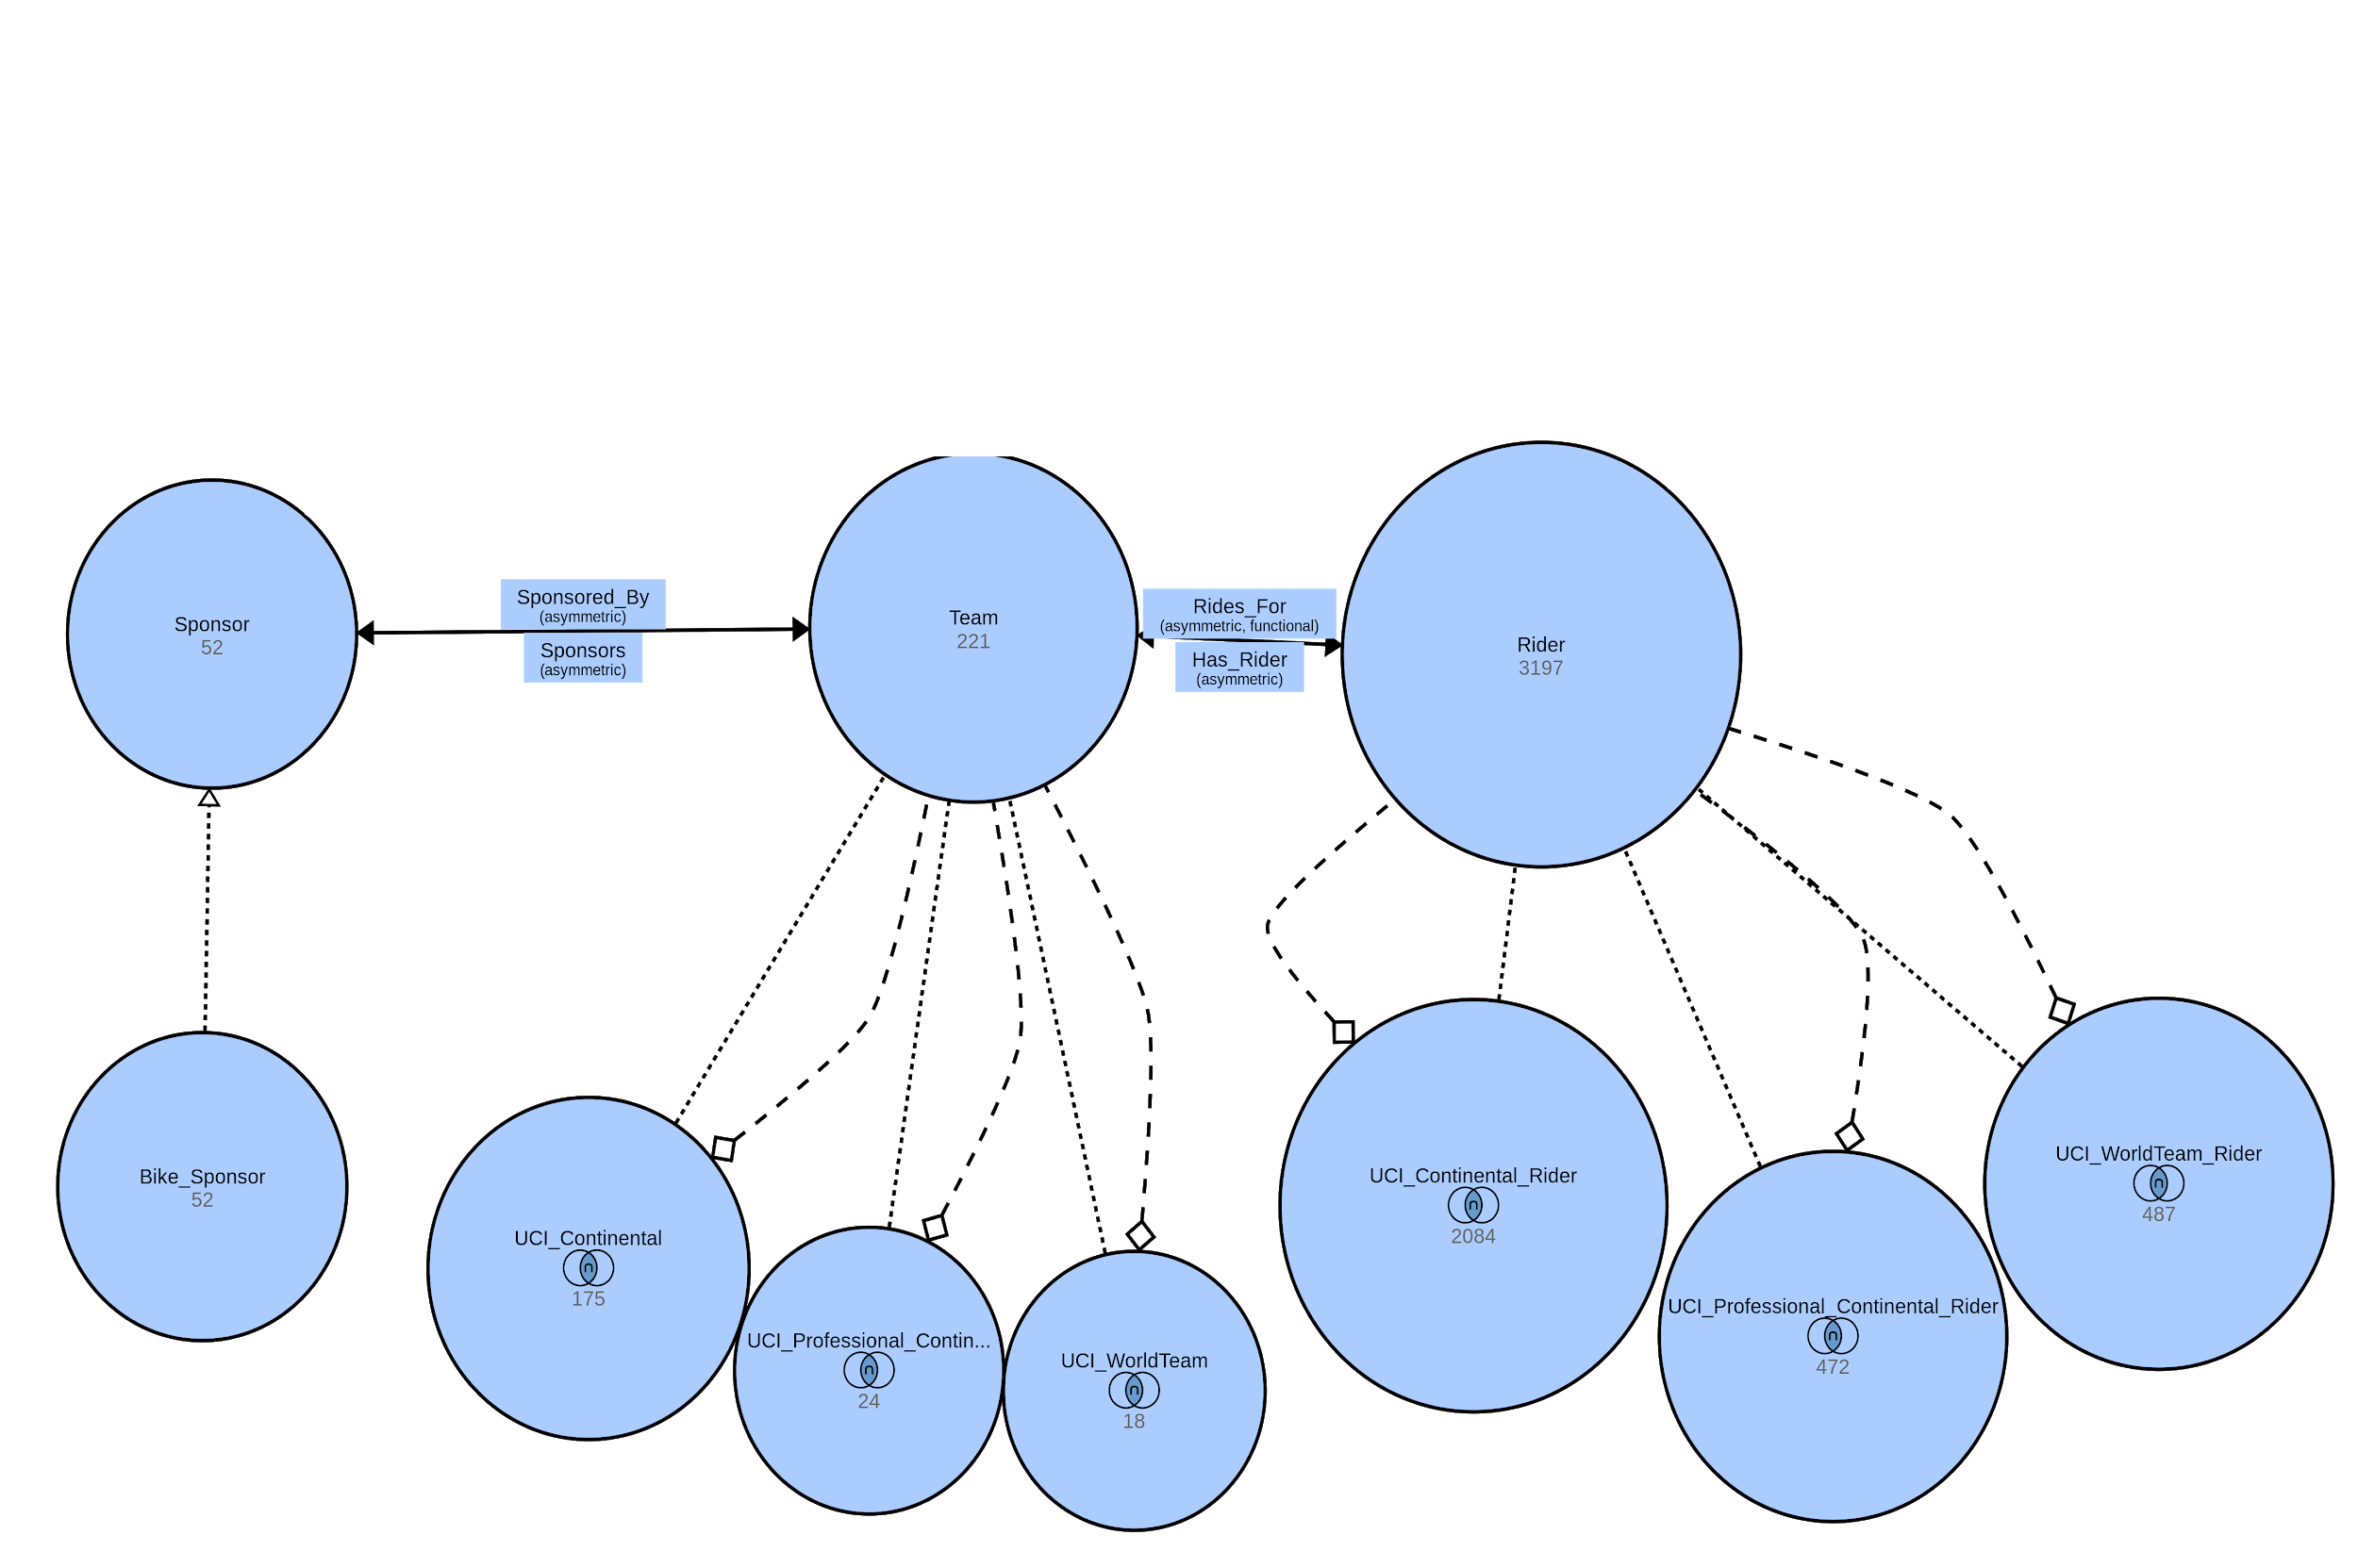
Classes

Slide 11
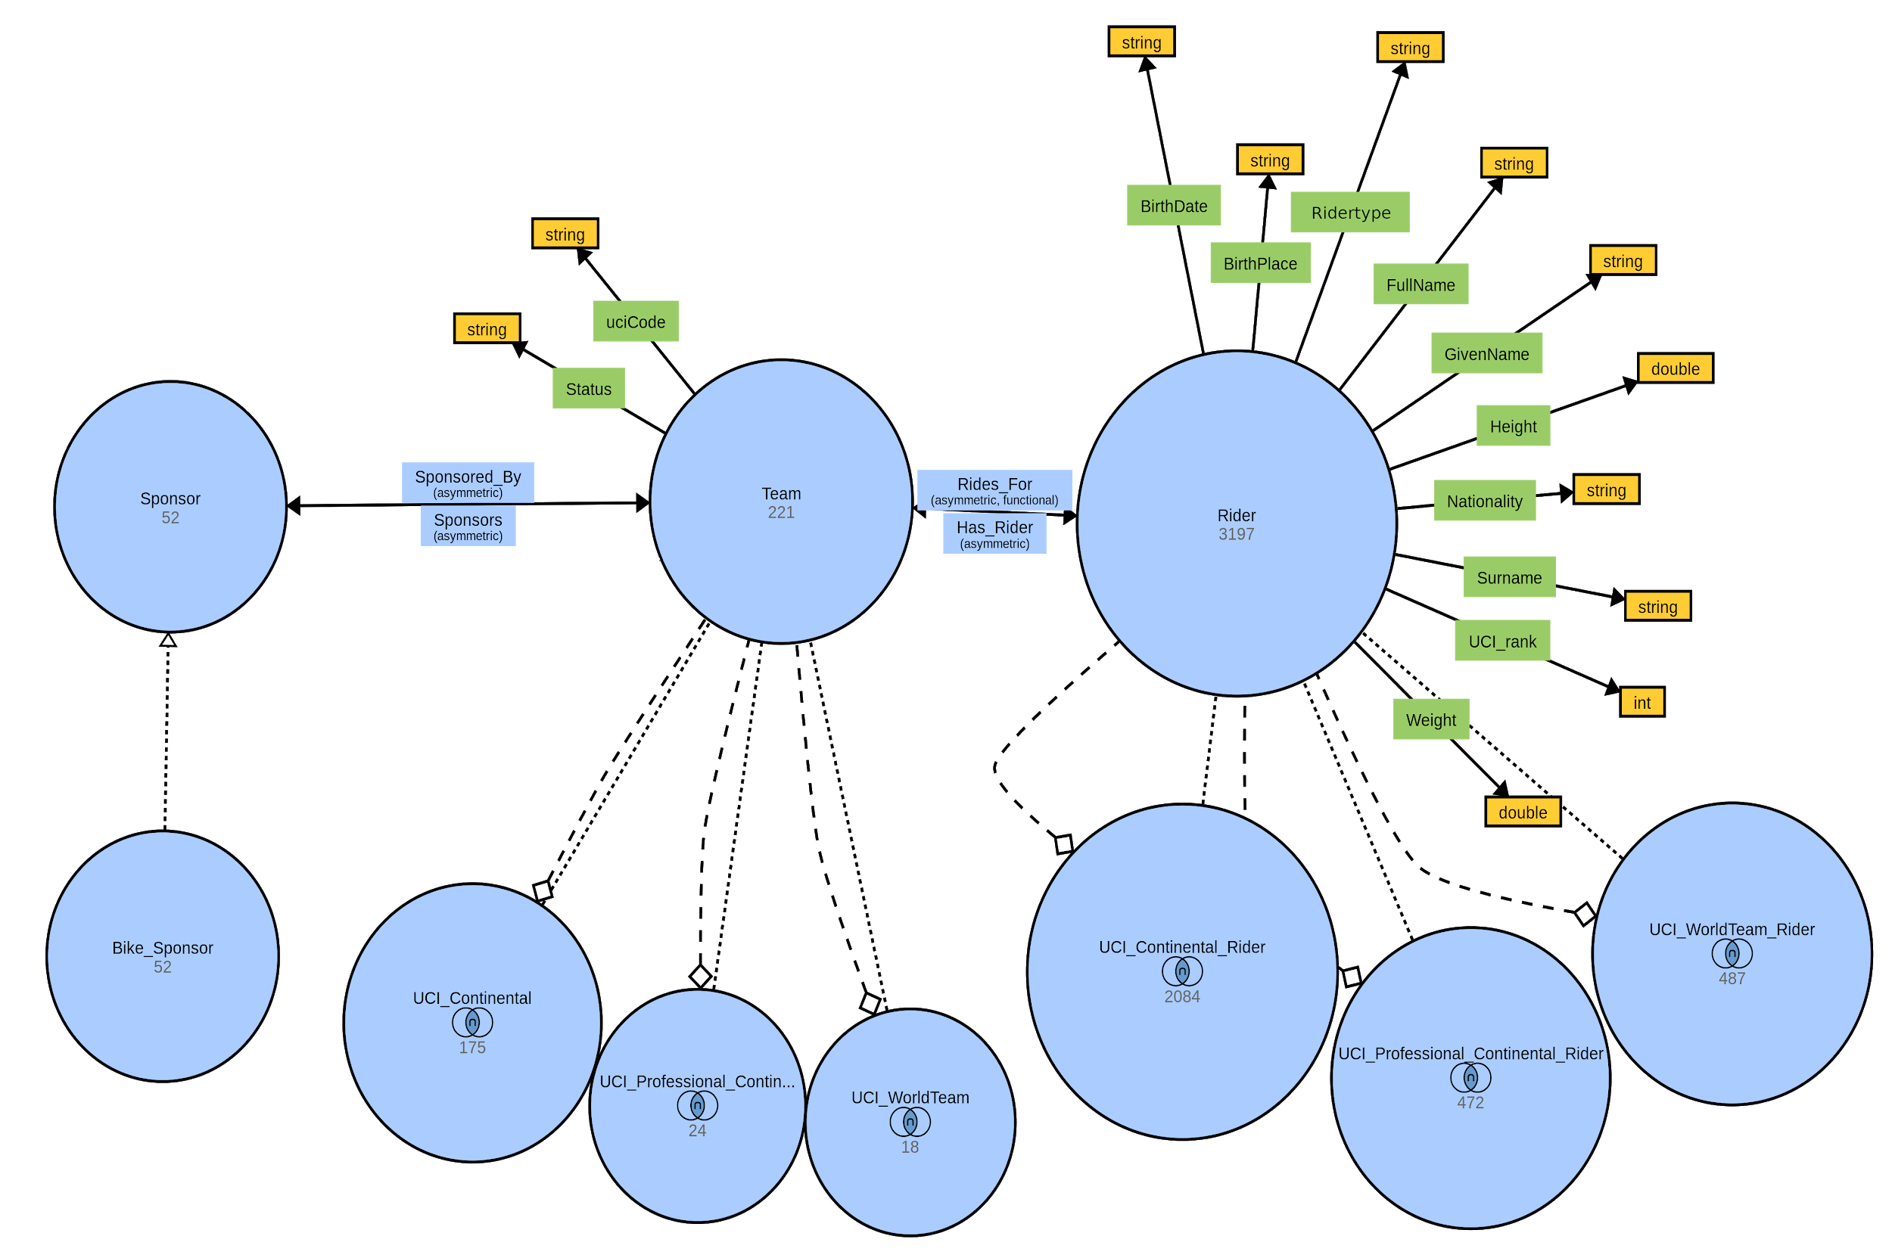
Properties

Slide 12
Intermediate results - Enriching riders
Riders
Total riders: 3197
Not found riders: 2390
Found riders: 807
Missing data added
Weight: 17
Height: 10
Corrected data
Given name: 27
Surname: 7
URI data added
Nationality: 3197
Birth place: 965
Pro team: 10

Slide 13
Intermediate results - ProCyclingStats riders
Data added from ProCyclingStats
UCI Rank: 1809
Birth dates: 3197
Weight: 1408
Height: 1452
Rider type: 2957
Pro team: 2323
Data that was not found
UCI Rank: 1273
Birth dates: 0
Weight: 1680
Height: 1646
Rider type: 240
Pro team: 67
Nationality: 0
Birth place: 1871

Slide 14

Questions?

